Slide 1

Online Movie Ticket Booking System
Presented by :
Kowshik Chowdhury (1804119)
Salman Farsi (1804102)
Md. Sajidul Mowla (1804100)
Antu Chowdhury (1804112)
Supervised by :
Md. Shafiul Alam Forhad , Assistant Professor, Department of CSE, CUET
Md. Atiqul Islam Rizvi, Lecturer, Department of CSE, CUET

Slide 2
This program is built on top of a website where moviegoers can buy tickets online. Anyone may purchase movie tickets for any theater in the country using our simple online booking system.
This system's goal is to provide moviegoers with information about a wide range of recently released films while also facilitating the sale of cinema tickets. Online booking is the foundation of the whole system.
Introduction

Slide 3
Booking movie tickets online using an internet platform is an appealing and comfortable experience. It enables us to reserve and buy tickets that are relevant to our film interests, all while enjoying at home on a regular basis of day or night. We worked on this database project to get fresh experience.
Motivation

Slide 4

ER Diagram

Slide 5
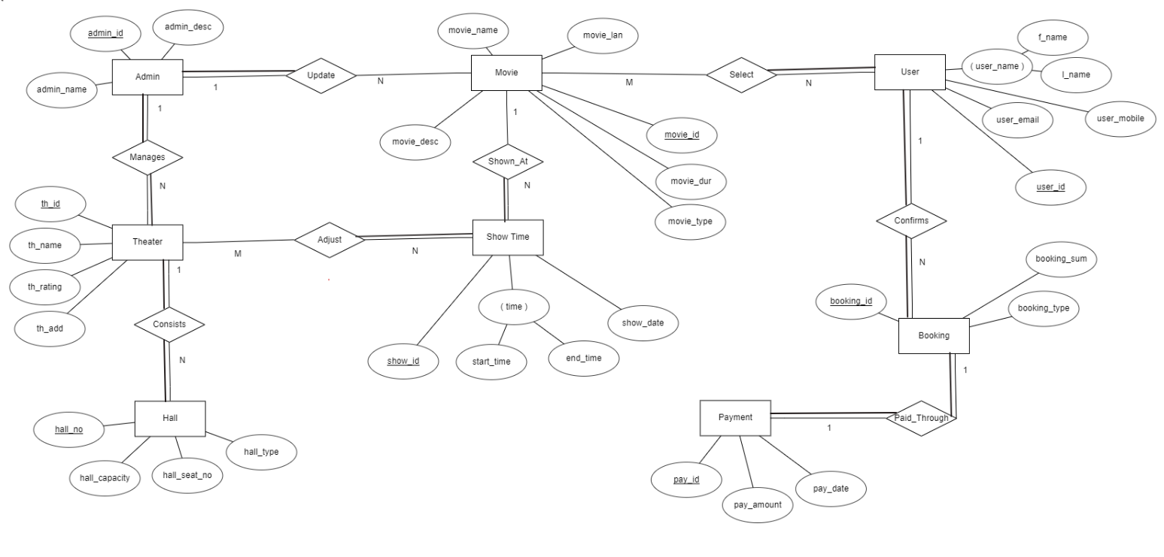

Slide 6
Short Note
Admin: In this entity, we have 3 attributes where admin_id is the primary key of the entity. Here, the admin panel will manage the theaters and update movies.
User: The user entity has 4 attributes and user_id is the primary key of the entity. In the system, user can select as their own interests and can confirm bookings after selecting movies.
Theater: Theater has also 4 attributes. And th_id is the primary key of theater entity. This entity consists of many halls and can adjust the show_time.
Movie: It has 6 attributes in total among them movie_id is the primary key of the entity. Movies are shown at different show time as it controls show_time.
Booking: Booking has 3 attributes where booking_id is the primary key of this entity. After booking, the users can pay through payment.
Payment: It has 3 attributes and pay_id is the primary key of this entity. By this entity, we have got the all payment which are paid by users .
Hall: It has 4 attributes of this system. And hall_no is the primary key of this entity.
Show_time: It is an another entity of this system which consists of 2 attributes. And show_id plays a role of primary key of this entity.

Slide 7

Mapping

Slide 8
a) ADMIN
admin_id | admin_name | admin_desc
User
user Id | f_name | l_name | user_mobile | user_email
Movie
movie_id | movie_name | movie_desc | movie_dur | movie_type | movie_len | ad_id
Payment
pay_id | pay_amount | pay_date
Theater
th_id | th_name | th_rating | th_add | ad_id
Booking
booking_id | booking_sum | booking_type | payment_id | cus_id
Hall
th_id | hall_no | hall_seat_no | hall_type | hall_capacity
Showtime
m_id | show_id | show_date | start_time | end_time
b)
Adjust
th_id | show_id
Selects
movie_id | user_id

Slide 9

Normalization

Slide 10
Normalization (1NF)
a) ADMIN
admin_id | admin_name | admin_desc
User
user Id | f_name | l_name | user_mobile | user_email
Movie
movie_id | movie_name | movie_desc | movie_dur | movie_type | movie_len | ad_id
Payment
pay_id | pay_amount | pay_date
Theater
th_id | th_name | th_rating | th_add | ad_id
Booking
booking_id | booking_sum | booking_type | payment_id | cus_id
Hall
th_id | hall_no | hall_seat_no | hall_type | hall_capacity
Showtime
Atomic Value
No multivalued, composite attribute
m_id | show_id | show_date | start_time | end_time
b)
Adjust
th_id | show_id
Selects
movie_id | user_id

Slide 11
Normalization (2NF)
a) ADMIN
admin_id | admin_name | admin_desc
User
user Id | f_name | l_name | user_mobile | user_email
Movie
movie_id | movie_name | movie_desc | movie_dur | movie_type | movie_len | ad_id
Payment
pay_id | pay_amount | pay_date
Theater
th_id | th_name | th_rating | th_add | ad_id
Booking
booking_id | booking_sum | booking_type | payment_id | cus_id
Hall
Must be in 1NF
All Primary Keys don’t functionally dependent on any subset of Candidate Key relation​
th_id | hall_no | hall_seat_no | hall_type | hall_capacity
Showtime
m_id | show_id | show_date | start_time | end_time
b)
Adjust
th_id | show_id
Selects
movie_id | user_id
Notes:
Admin id is not unique so it is not usable for primary key (MOVIE)
In THEATER same process

Slide 12
Normalization (3NF)
a) ADMIN
admin_id | admin_name | admin_desc
User
user Id | f_name | l_name | user_mobile | user_email
Movie
movie_id | movie_name | movie_desc | movie_dur | movie_type | movie_len | ad_id
Payment
pay_id | pay_amount | pay_date
Theater
th_id | th_name | th_rating | th_add | ad_id
Booking
booking_id | booking_sum | booking_type | payment_id | cus_id
Hall
th_id | hall_no | hall_seat_no | hall_type | hall_capacity
Showtime
Must be in 2NF
Has no transitive functional dependencies
m_id | show_id | show_date | start_time | end_time
b)
Adjust
th_id | show_id
Selects
movie_id | user_id
Notes:
Admin id is not unique so it is not usable for primary key (MOVIE)
In THEATER same process

Slide 13

Tables

Slide 14
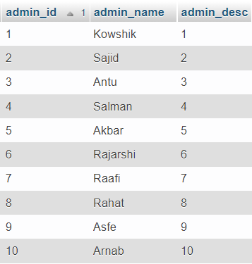
Table (ADMIN)

Slide 15
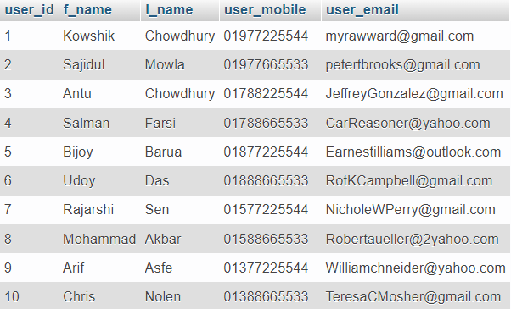
Table (USER)

Slide 16
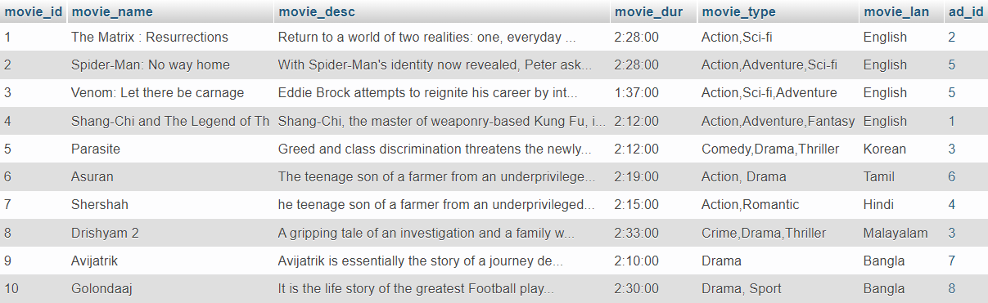
Table (MOVIE)

Slide 17
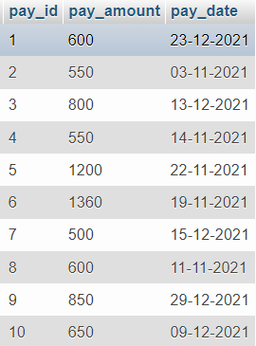
Table (PAYMENT)

Slide 18
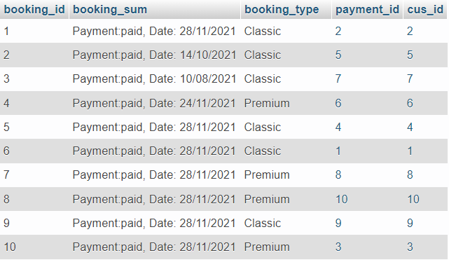
Table (BOOKING)

Slide 19
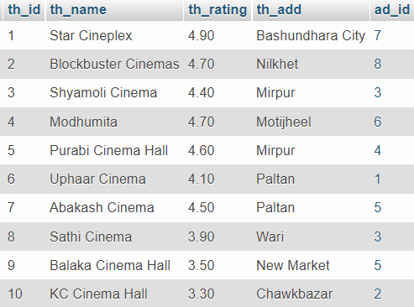
Table (THEATER)

Slide 20
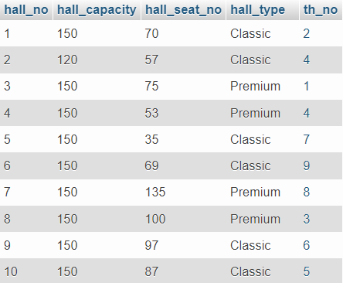
Table (HALL)

Slide 21
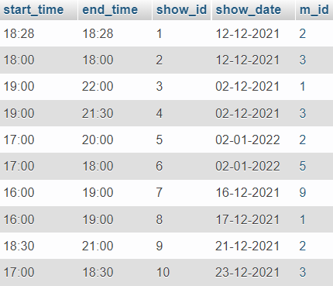
Table (SHOWTIME)

Slide 22
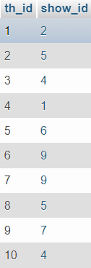
Table (ADJUST)

Slide 23
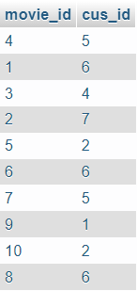
Table (SELECTS)

Slide 24

Query

Slide 25
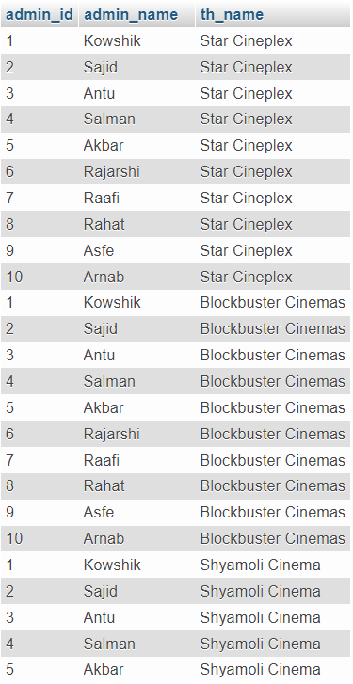
Query
Display Theater Name managed by admins
SELECT admin_id,admin_name,th_name
FROM admin natural join theater

Slide 26
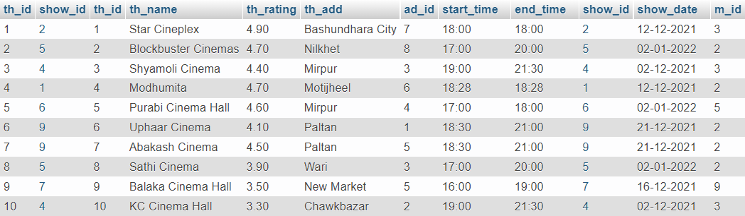
Query
SELECT *
FROM adjust inner join theater
on theater.th_id = adjust.th_id
inner join showtime
on showtime.show_id = adjust.show_id
2. Display showtime managed by Theater

Slide 27
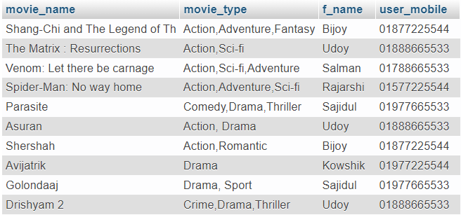
Query
3. Display movie info selected by Users
SELECT movie_name, movie_type, f_name, user_mobile
FROM selects inner join movie
on movie.movie_id = selects.movie_id
inner join user
on user.user_id = selects.cus_id

Slide 28
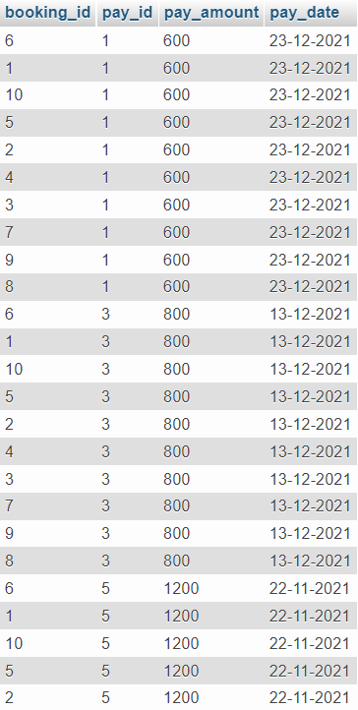
Query
4. Display Booking info paid per Payment
SELECT booking.booking_id, payment.pay_id, payment.pay_amount, payment.pay_date
FROM booking, payment
HAVING payment.pay_amount > 550

Slide 29
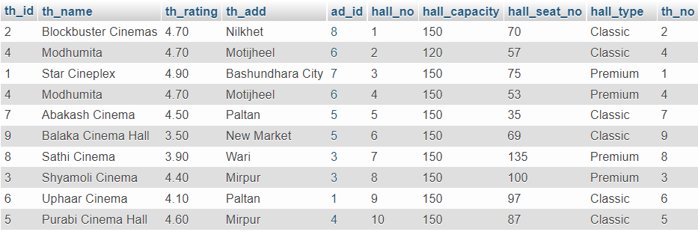
Query
5. Display all info from hall consisted by Theater
SELECT *
FROM theater, hall
WHERE theater.th_id = hall.th_no

Slide 30
Conclusion
Online movie ticket booking systems allow theater owners to handle their ticket sales online. The admin panel can keep track of payments, reservations, etc. They can also keep track of people who purchased tickets online. They may also monitor whether a consumer paid a particular amount for reservations.
It minimizes data entering time and speeds up the booking processes. It saves time and energy while buying tickets. The technology is designed to solve issues like crowding in front of cinemas.
It would also enable the admin panel to benefit more from our suggested method while increasing public interest. We will endeavor to improve the front-end in the future.

Slide 31
Thank You

